Slide 1
STUDENTS MANAGEMENT APP
A project made in the context of sev – regeneration Skills4Jobs initiative at university of economics and business for Software Engineers
begiana elmazai

Slide 2
INTRODUCTION
There was a need to create a web Application to manage the enrollments of students in courses and the teachers teaching each course.
So , I used ASP.NET CORE framework coding with C# , as this can integrate a unified solution of our code/business logic and graphical interfaces.

Slide 3
Application components
1.A database at SQL Server Management Studio,
2.C# code
3.Razor pages

Slide 4
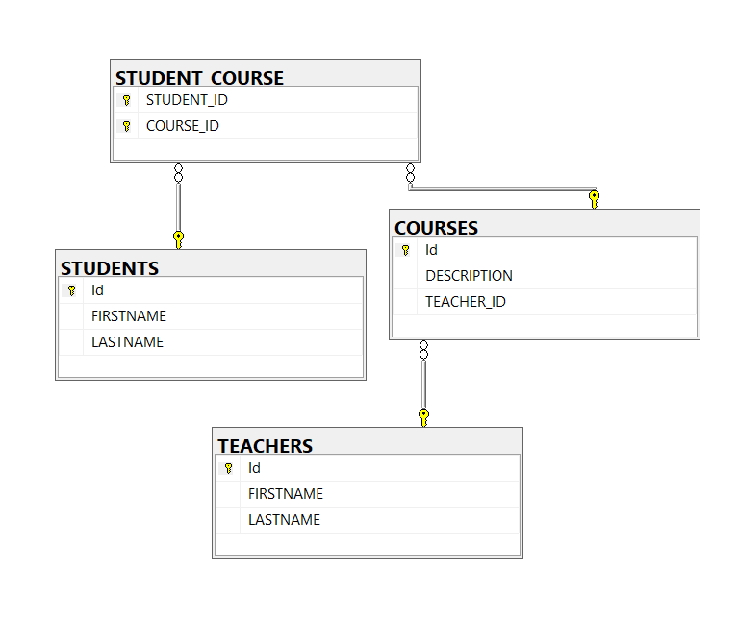
1. DATABASE
Consist’s of four tables
STUDENTS (Id, FIRSTNAME, LASTNAME) [ Id Primary Key ]
TEACHERS (Id, FIRSTNAME, LASTNAME) [ Id Primary Key ]
COURSES (Id, DESCRIPTION, TEACHER_ID) [ Id Primary Key ]
TEACHER_ID Foreing key to TEACHERS Table at Id
STUDENT_COURSE (STUDENT_ID , COURSE_ID)
[ Both fields compose Primary Key and
STUDENT_ID Foreing key to STUDENTS Table at Id
COURSE_ID Foreing key to COURSES Table at Id ]

Slide 5
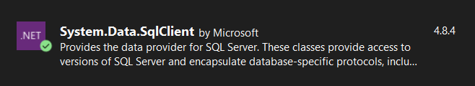
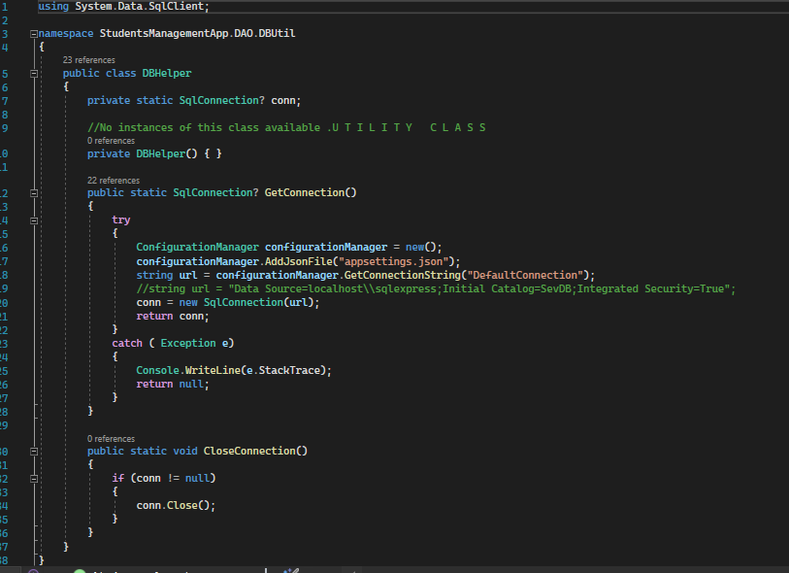

1. DATABASE connection with vs code
Connection with DB is done by Installing Nuget Package SQLClient and provided the classes and interfaces that create connection with database, command queries, read or send data.
In this project, DB Helper Class attempts the connection to by sending a connection string.

Slide 6
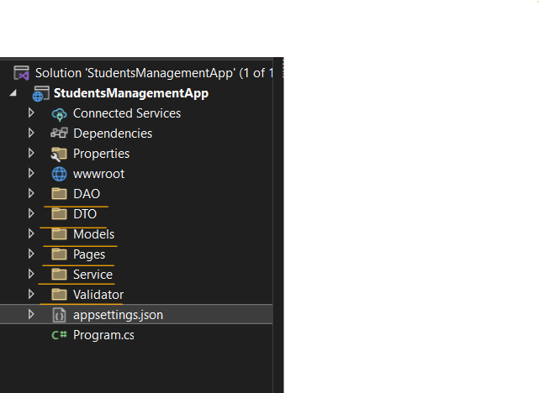
2. CODE design
Namespaces
The application follows the design architecture SOA (Service-oriented-architecture) which obeys the design principle Seperation of Concern. This is achieved by separating the code into small and self-contained layers (namespaces) , which makes it easier to debug, maintain, extend and reuse for future additions. The data binding between the layers that have to communicate is loosely coupled and in our case is done with dependency injection via interfaces.

Slide 7
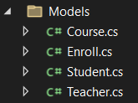
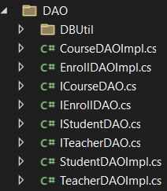
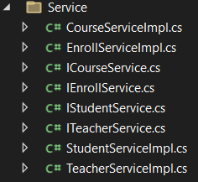

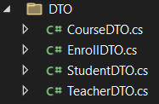
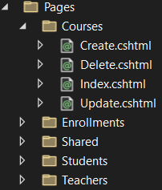
2.a Namespaces
MODELS
DAO
SERVICE
VALIDATOR
DTO
PAGES
«
«
«
«
«
Helper class that checks if the object transferred is valid
Data Transfer Object tranfers data from user-input to service layer
The classes in models are representations of data in the database
Service layer represents the public API with documentation
communicating with DAO layer
Holds for views(csHtml) and controllers that manages requests from user
Data Access layer communicates with the database via DBUtil Class.

Slide 8
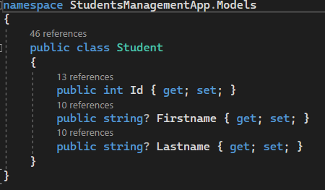
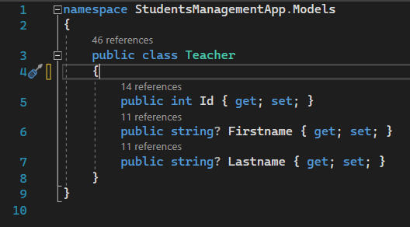
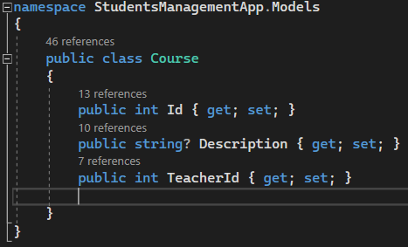
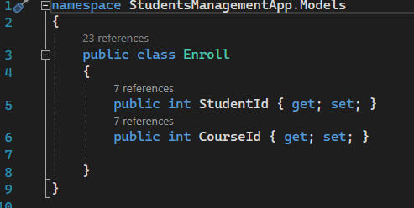
2.B.models
Classes representing each table of database with fields as fields of the tables

Slide 9
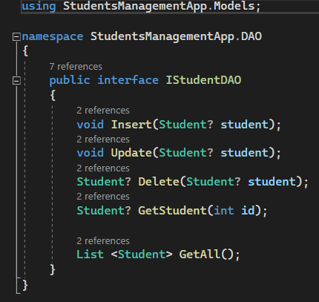
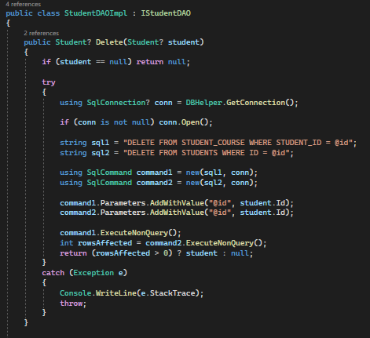
2.B.DAO
DAO layer contains interfaces and classes that implement them. For example ..
Each CRUD method uses DB helper first to connect to database and then to command queries and read or send data
Interface
Delete method implementation

Slide 10
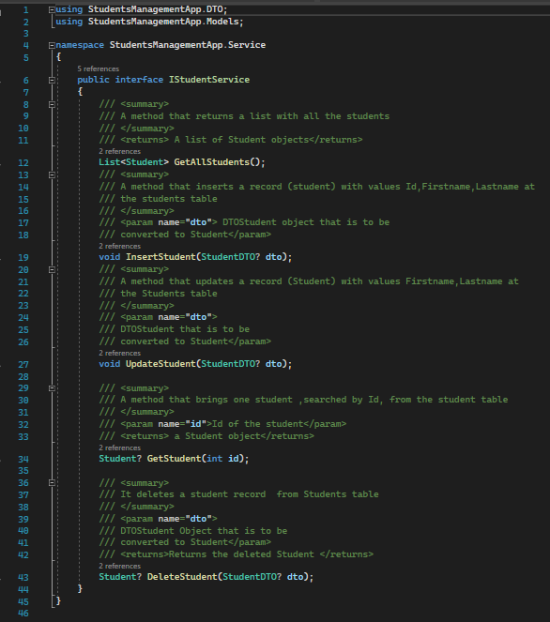
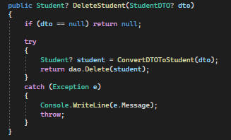
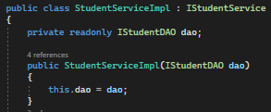
2.B.Service
Service
Interface
Service layer also contains interfaces and classes that implement them but also holds for public API and documentation explaining utility .
Service Delete Method Implementation
Service layer calls methods from DAO layer with dependency injection

Slide 11
2.B.DTO
DTO like model classes but serves communication between controllers and service layer

Slide 12
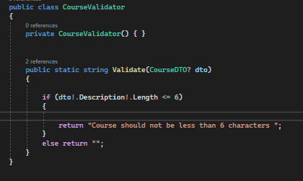
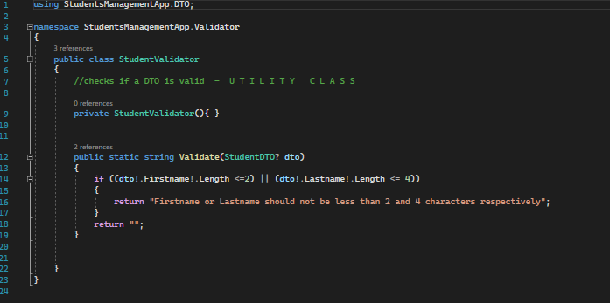
2.B.Validator
Checks if DTOS are valid

Slide 13
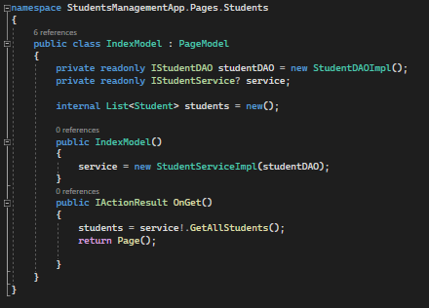
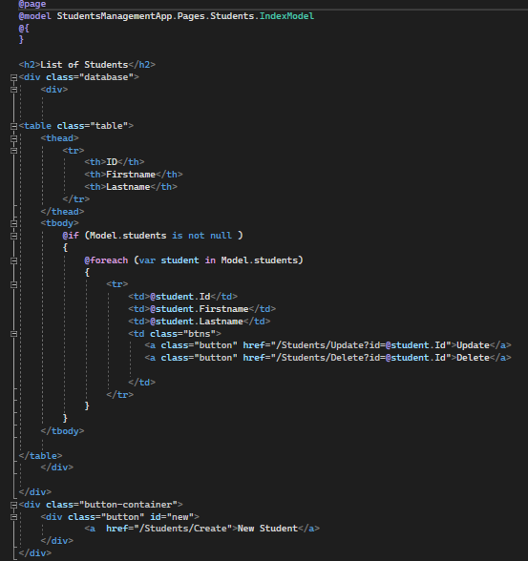
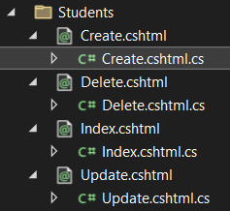
3.RAZOR PAGES
Razor pages contains the view (csHtml) file and the controller class that manages the requests of the user.
The HTML page that is sent to user
Every time a request is made a new html page is sent back. Each razor pages represent a CRUD action . For example IndexModel calls GetAllStudents() from Service layer

Slide 14
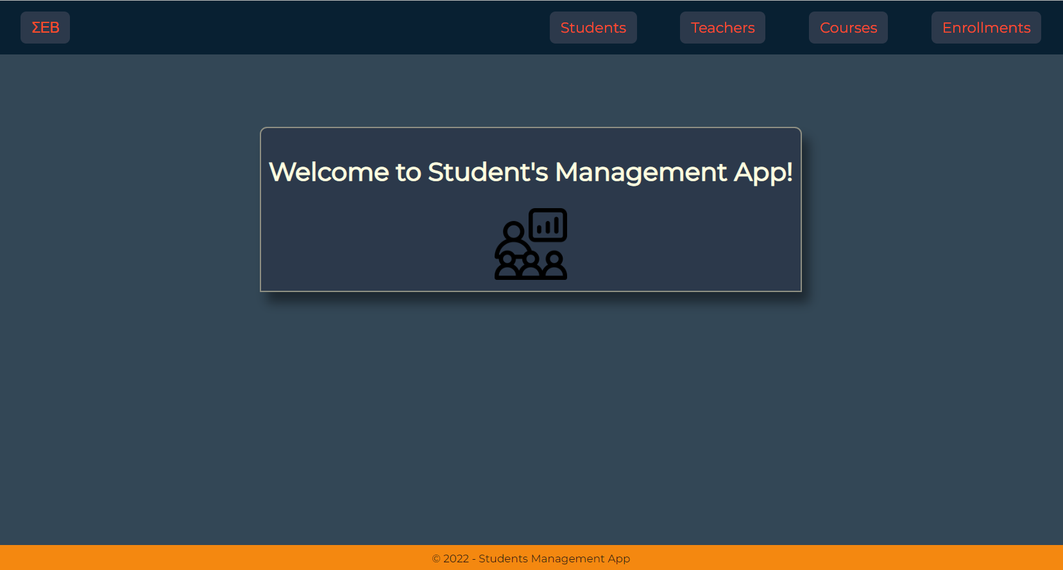
DEMONSTRATION
HOMEPAGE

Slide 15
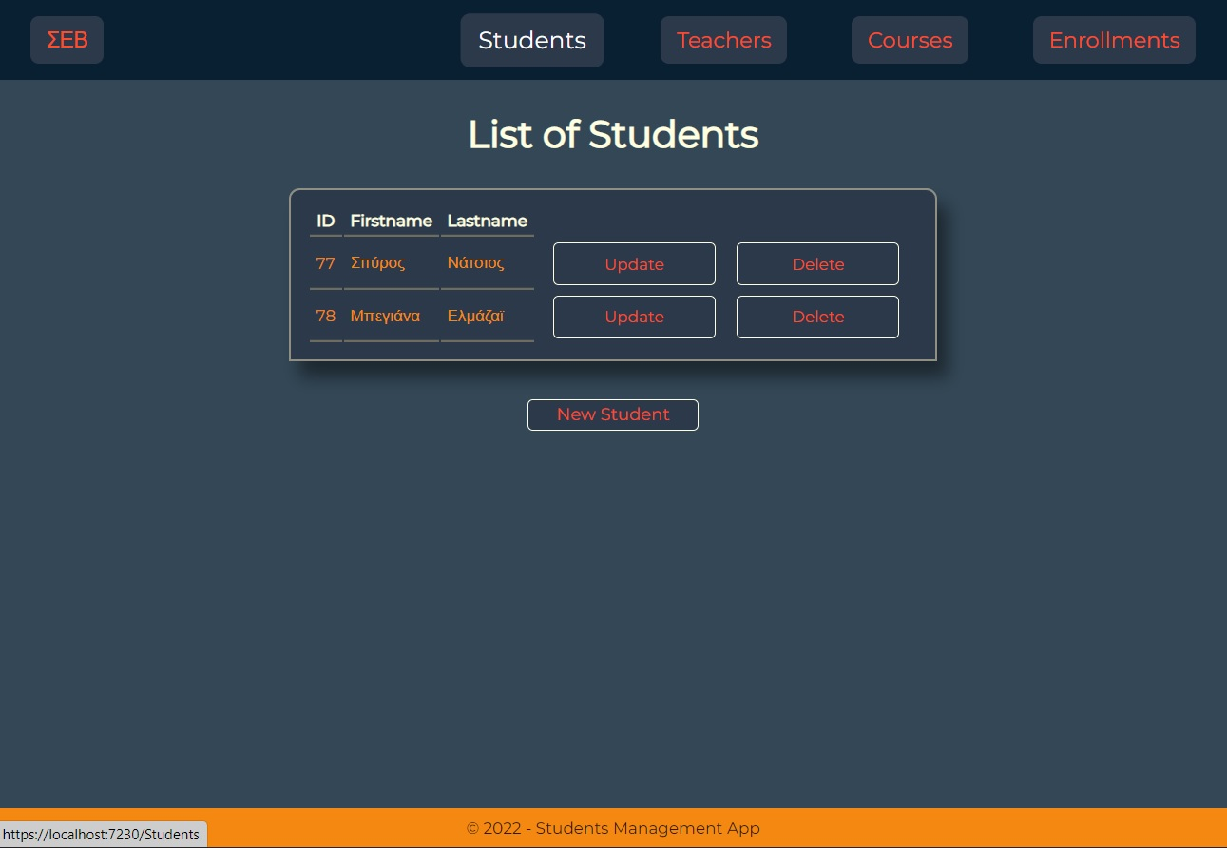
DEMONSTRATION
Students page

Slide 16
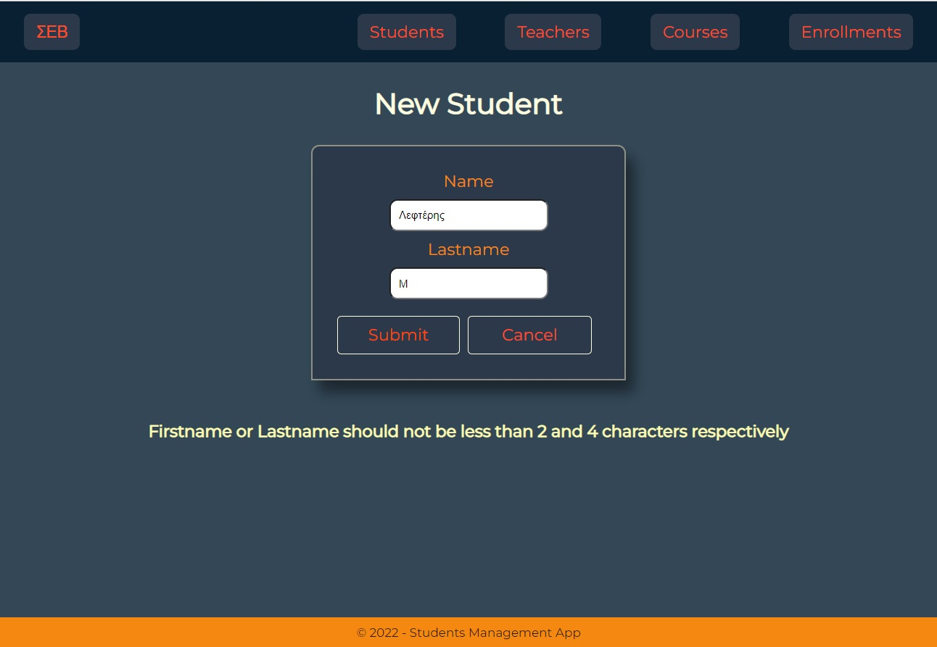
DEMONSTRATION
Create student
It throws error message: name or lastname is under 2 or 4 charachters

Slide 17
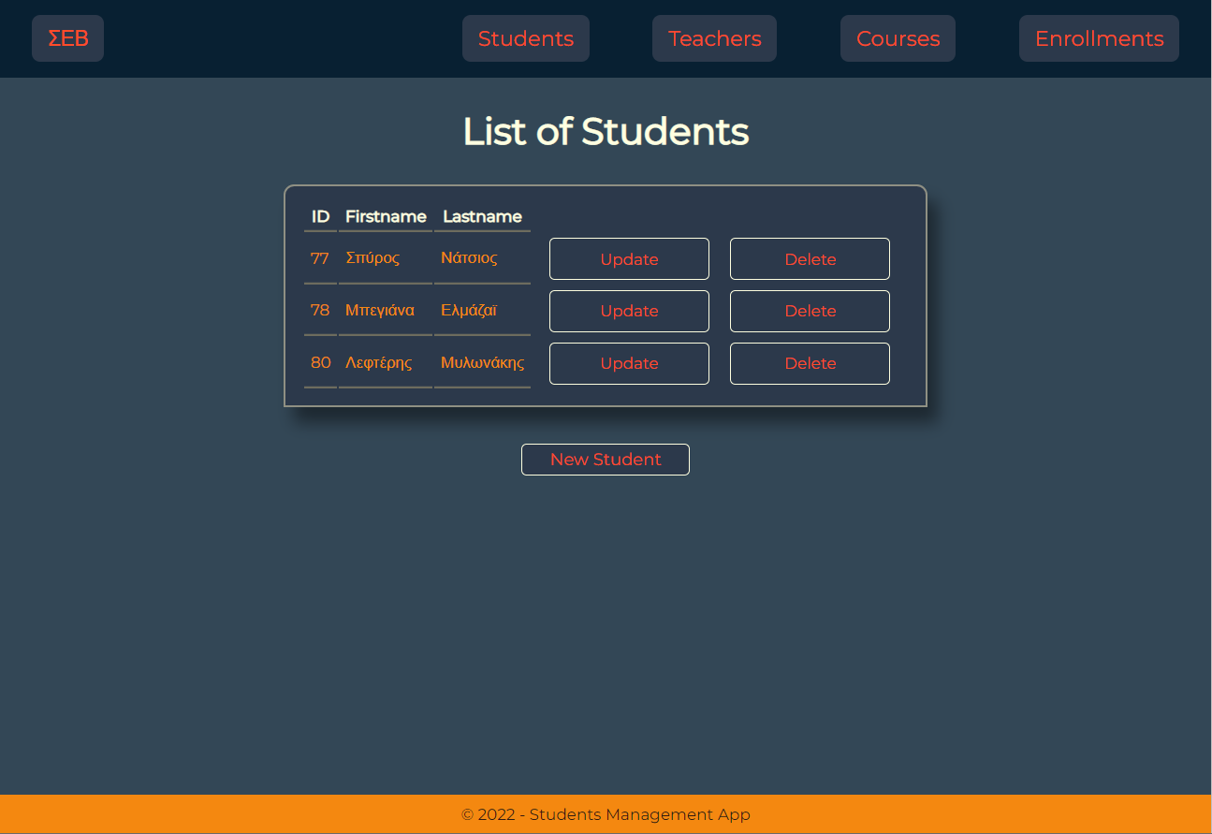
DEMONSTRATION
Student created

Slide 18
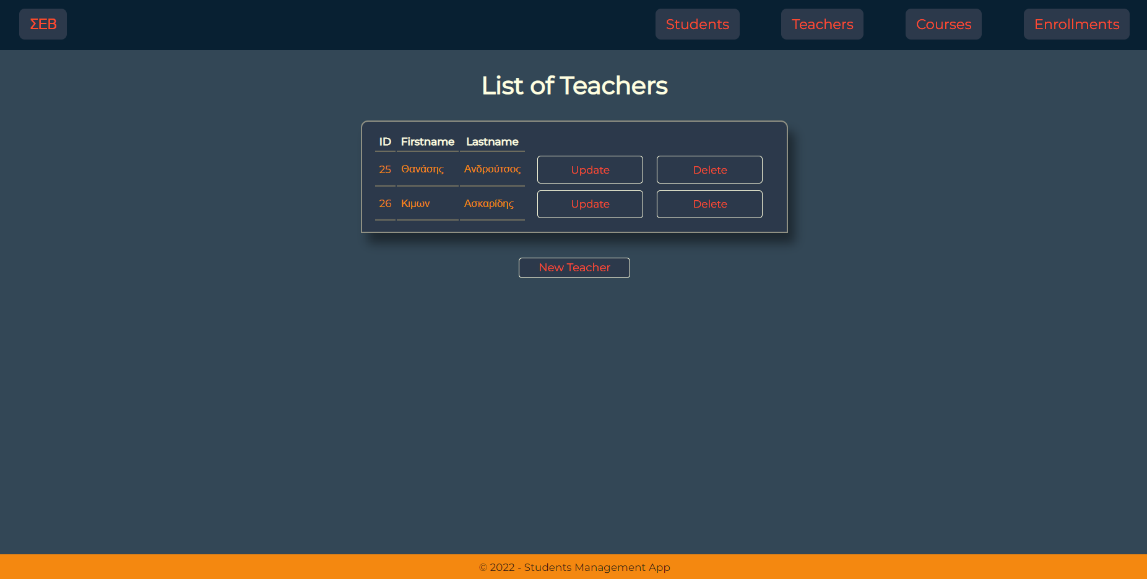
DEMONSTRATION
Same goes with
Teacher

Slide 19
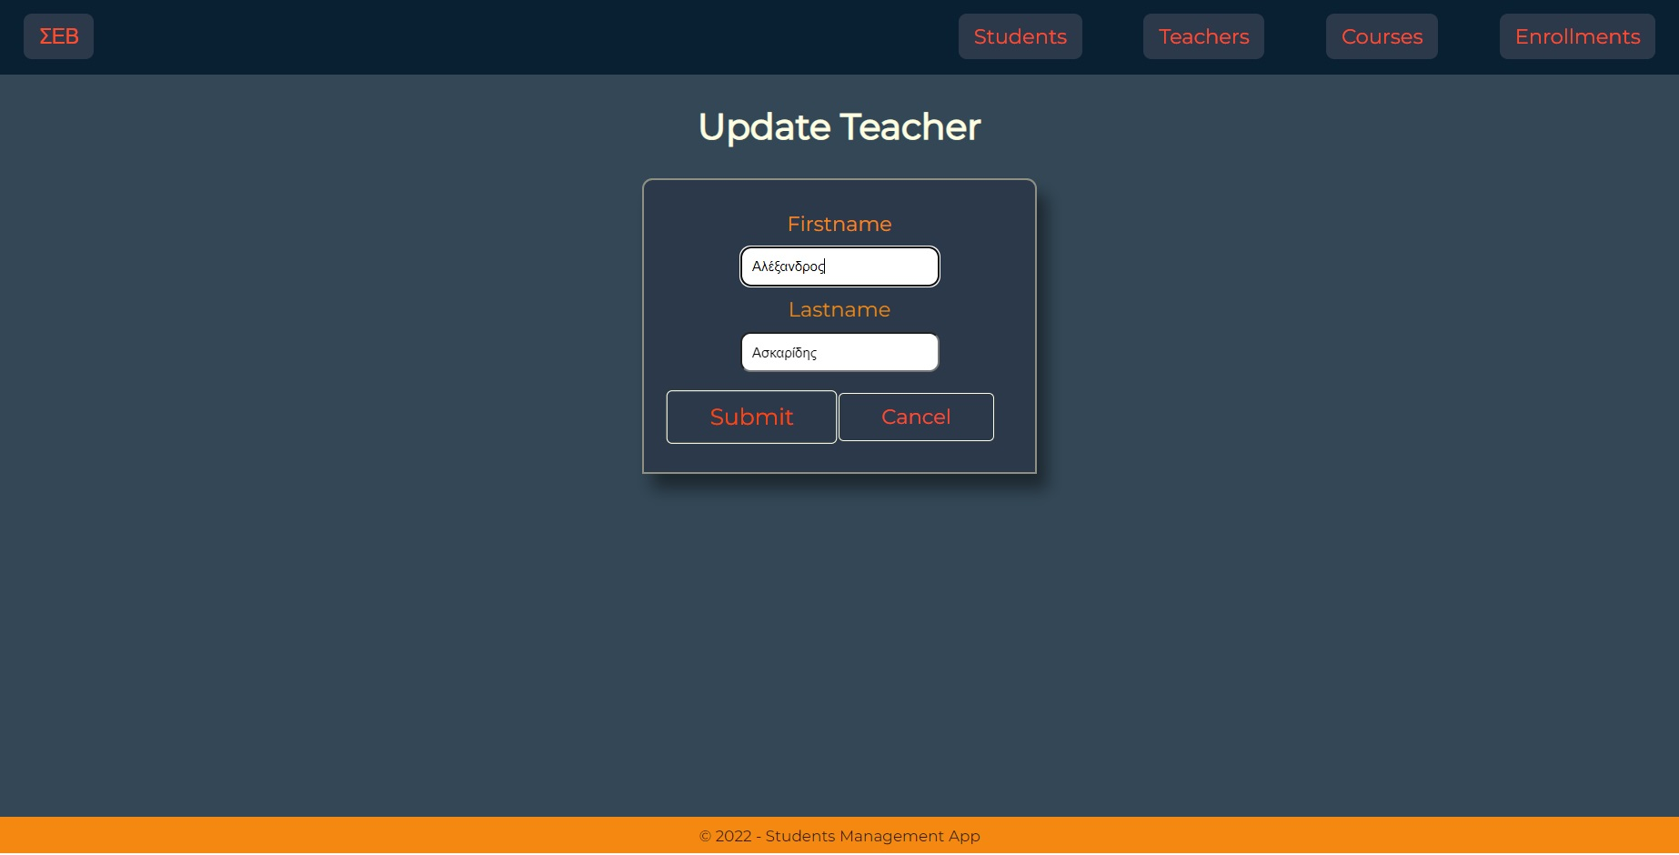
DEMONSTRATION
Update Teacher

Slide 20
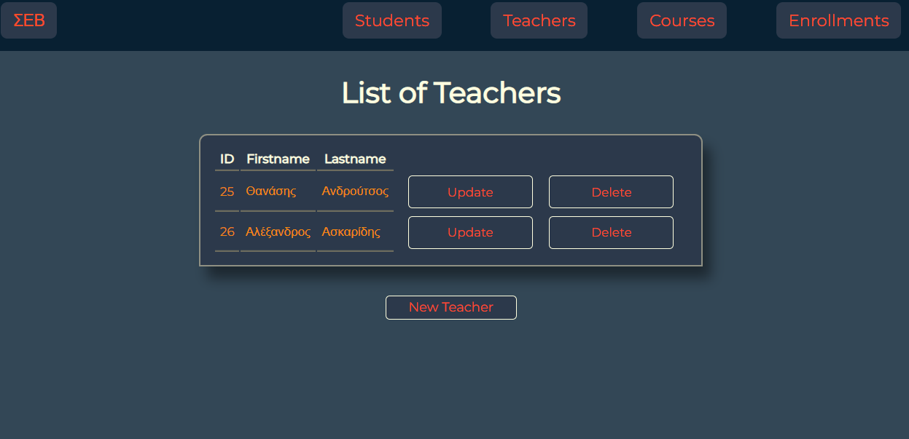
DEMONSTRATION
Teacher Updated

Slide 21
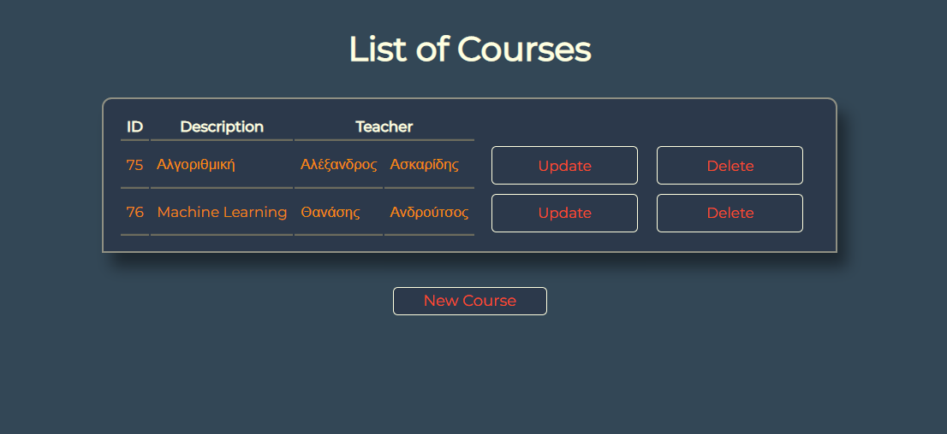
DEMONSTRATION
Courses

Slide 22
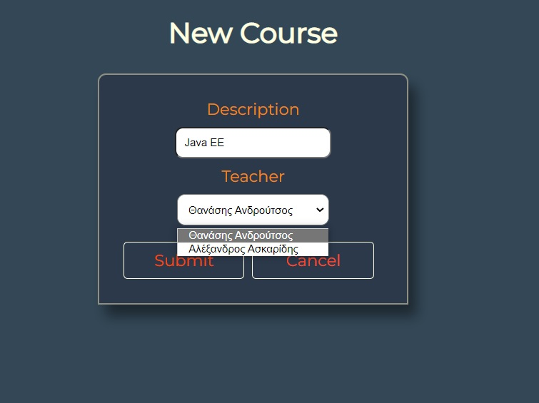
DEMONSTRATION
Create Course
It is required to choose an already inserted teacher

Slide 23
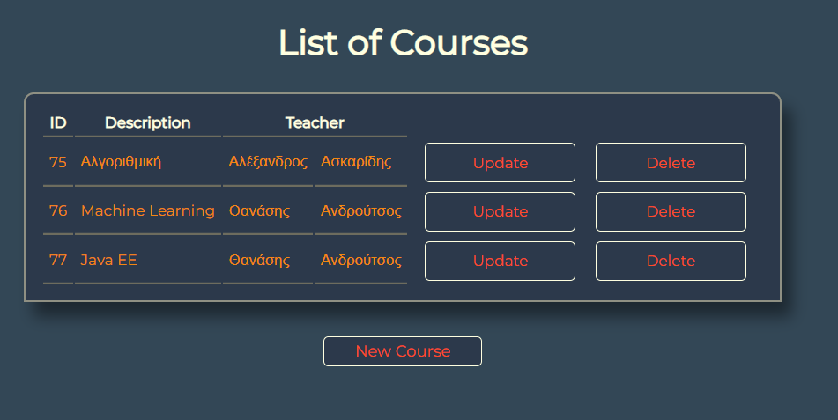
DEMONSTRATION
Course Created
It is required to choose an already inserted teacher

Slide 24
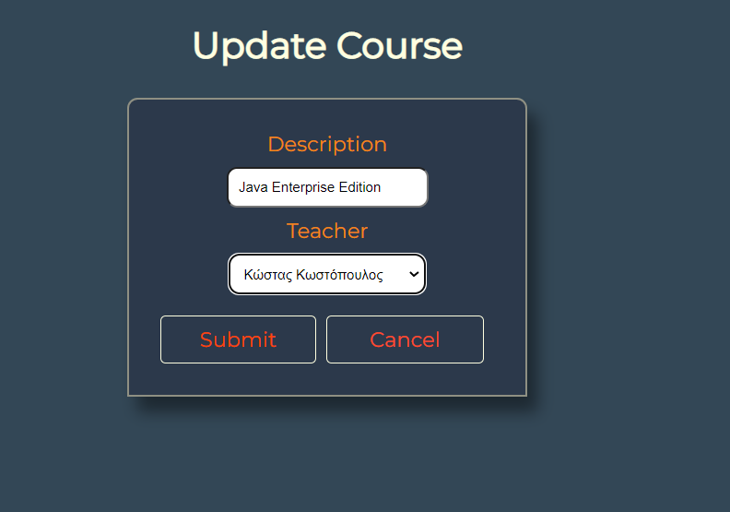
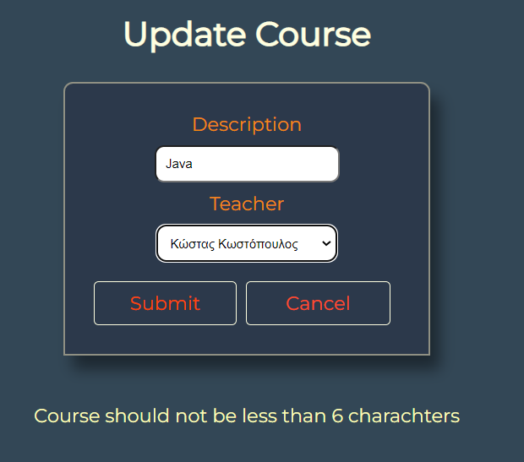
DEMONSTRATION
Update
Course
It throws error message: course should not be under 6 charachters

Slide 25
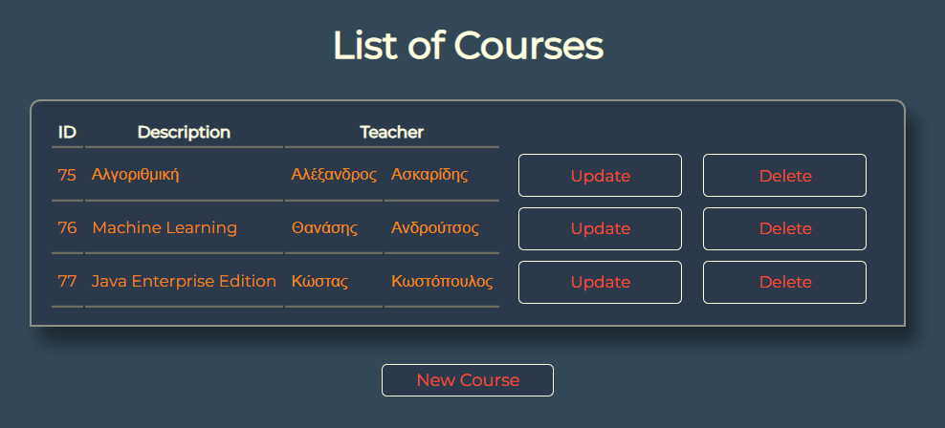
DEMONSTRATION
Course
Updated

Slide 26
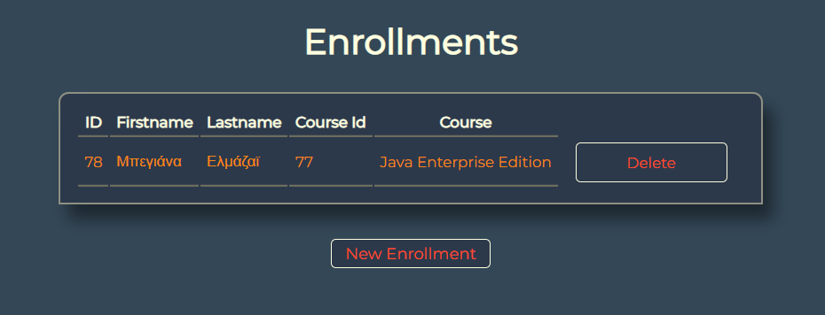
DEMONSTRATION
Enrollments

Slide 27
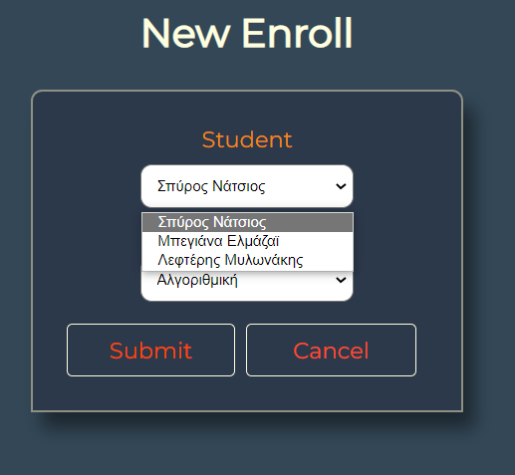
DEMONSTRATION
Create Enroll
It is required to choose already inserted Students and Courses

Slide 28
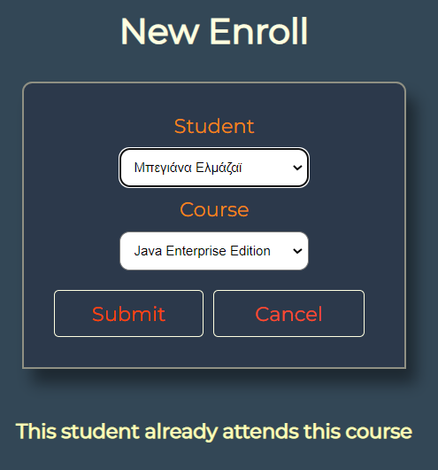
DEMONSTRATION
Create Enroll
It throws error if you make the same enroll

Slide 29
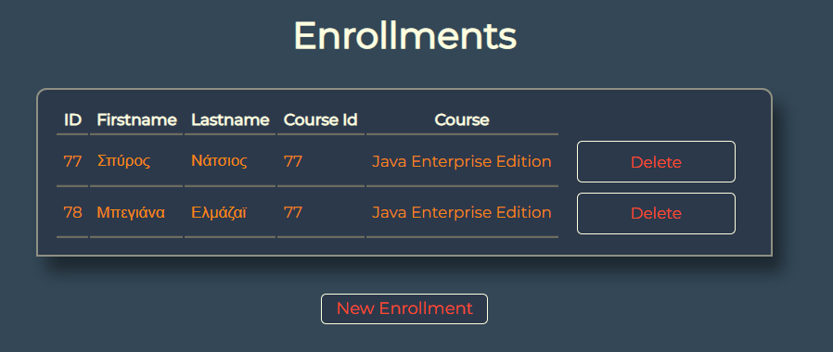
DEMONSTRATION
Enrollment Created

Slide 30
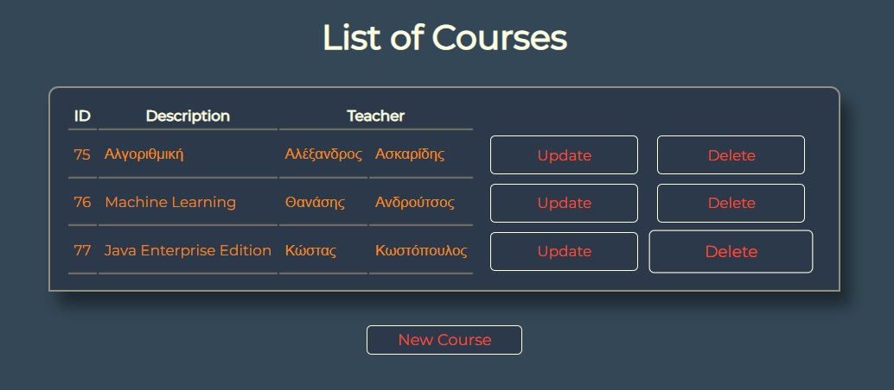
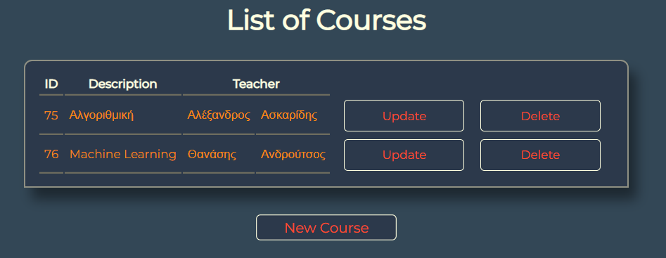
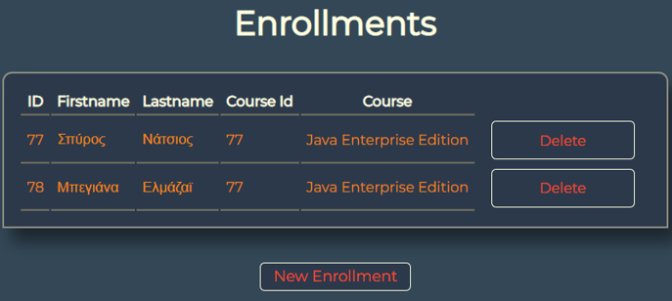
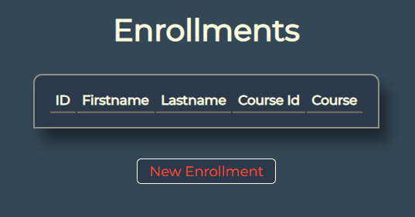
DEMONSTRATION
When you delete a course also enrollments in this course are deleted

Slide 31
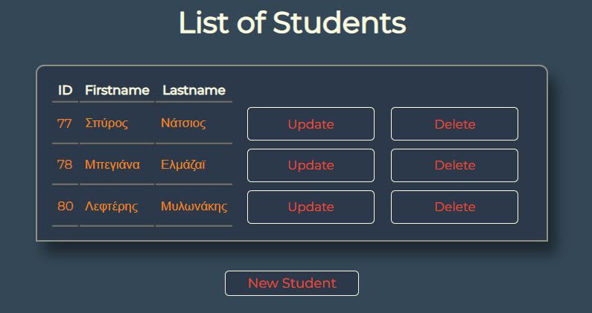
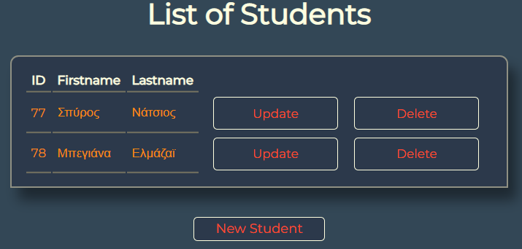
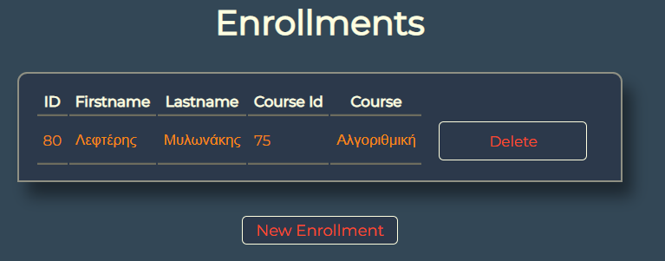
DEMONSTRATION
When you delete a student also enrollments of this student are deleted

Slide 32
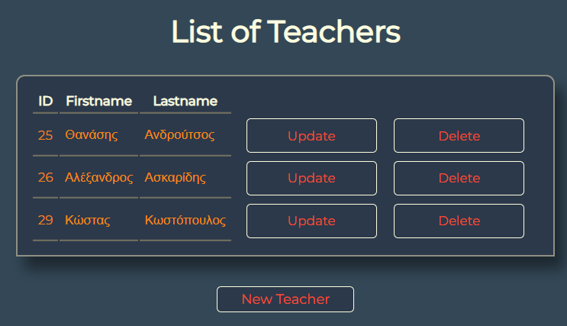
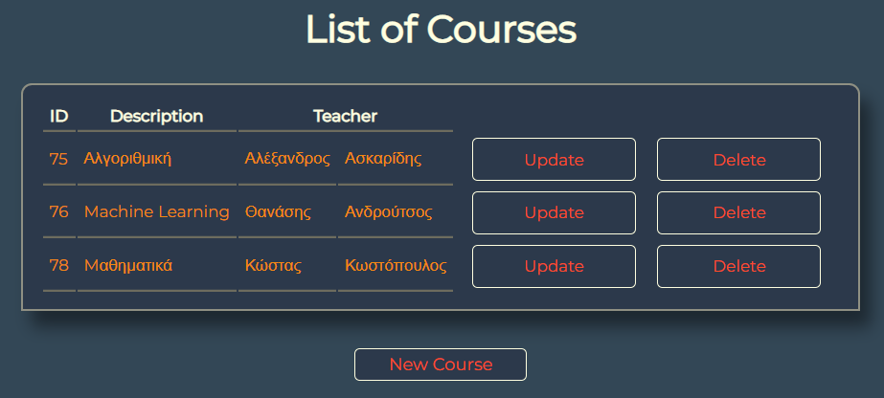
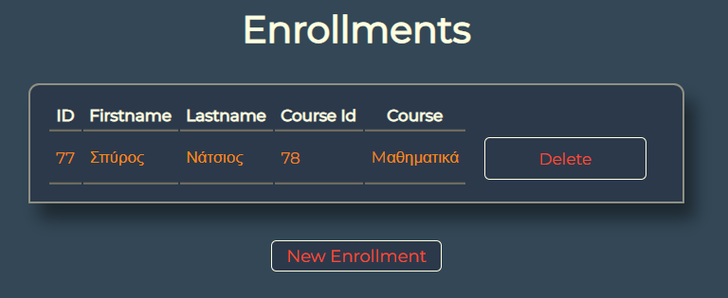


DEMONSTRATION
When you delete a teacher also courses and enrollments in this course are deleted

Slide 33
SOURCES
Notes from Thanasis Androutsos , also the teacher leading this course
https://en.wikipedia.org/wiki/Service-oriented_architecture

